Slide 1
Rhetorical Devices
the art of influencing people to believe you
PowerPoint created by Becca Boensch, Wando High School, 2016.

Slide 2
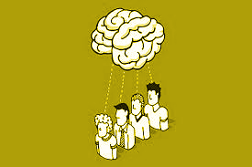
What Are Rhetorical Devices?
They are techniques that an author or speaker uses to persuade the audience or reader into believing what they believe.

Slide 3
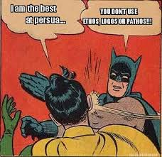
Why do we use them?
Rhetorical devices are most generally used in arguments or debates. The devices help gain support for an individual's argument. It also makes a person a better debater.

Slide 4
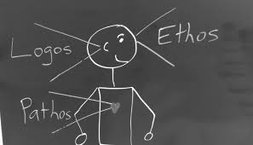
The Devices
Logos
Pathos
Ethos

Slide 5
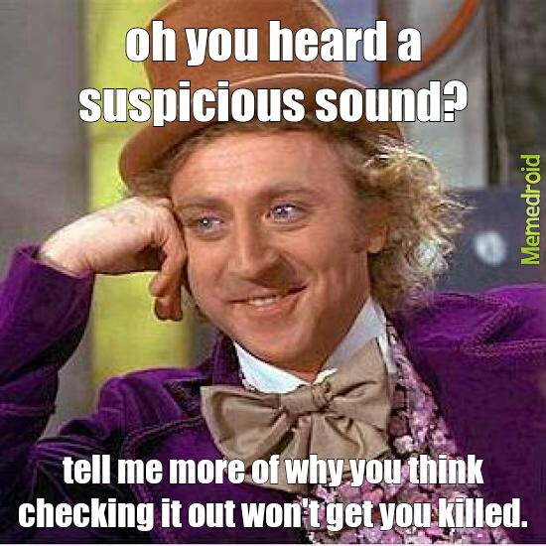
Logos
Greek word for “logic”
Appeals to audience/readers by using logic or reason
How would you do this?
Facts
Evidence
Common Sense

Slide 6
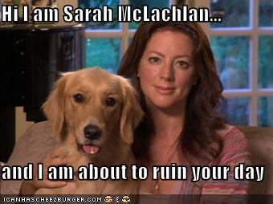
Pathos
Greek word for “Suffering”
Persuades readers/audience by appealing to their emotions
How would you use this?
Sympathy
Empathy
Sadness
Happiness
Anger

Slide 7
Ethos
Greek word for “Character”
To appeal to the audience/readers based on the author’s/speaker's credibility or character.
How would you use this?
Important title
Popularity
Reputation
Years of experience
Personal experience

Slide 8
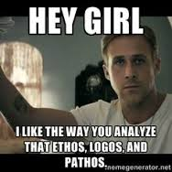
Quick Summary
Rhetorical Devices:
What: devices used to persuade people
Why: To gain supporters for someone's argument
Logos: logic
Pathos: emotions
Ethos: credibility/character

Slide 9
Resources
Literarydevices.net
Owl.english.purdue.edu

Slide 10
https://www.youtube.com/watch?v=HxpfkP_KWRA
https://www.youtube.com/watch?v=xq8trrEecGg
https://www.youtube.com/watch?v=SKL254Y_jtc
https://www.youtube.com/watch?v=6HNKqffU3Cc
https://www.youtube.com/watch?v=fx-lyjc7h7Q
https://www.youtube.com/watch?v=PplMjgh_QlM
https://www.youtube.com/watch?v=DcsRPw72sWw

